Slide 1
Retail Business Performance & Profitability Analysis
Objective:
Analyzing retail transactional data to identify profit-draining categories, inventory inefficiencies, and seasonal trends.
Tools Used:
SQL | Python | Power BI
Prepared by:
Y Jahnavi

Slide 2
BUSINESS PROBLEM
Retail businesses often focus on increasing sales, but:
High sales do not always mean high profit
Poor inventory decisions increase holding costs
Lack of seasonal planning leads to profit loss
Key Question:
How can data be used to improve retail profitability and inventory efficiency?

Slide 3
PROJECT OBJECTIVES:
Analyze sales and profit across product categories
Identify profit-draining categories
Study relationship between inventory quantity and profit
Analyze seasonal profit trends
Provide data-driven business recommendations

Slide 4
DATASET OVERVIEW
Dataset Type: Retail transactional sales data
Key Columns:
Order Date
Category
Sub-Category
Sales
Profit
Quantity
Region
Data Size:
Order-level transaction records across multiple regions and categories

Slide 5
TOOLS & APPROACH
SQL (SQLite)
Data cleaning
Aggregation
Profit margin calculation
Python (Pandas)
Correlation analysis
Inventory vs profit analysis
Trend analysis
Power BI
Interactive dashboards
KPI visualization
Business insight generation

Slide 6
DATA CLEANING PROCESS:
Removed null sales, profit, and quantity records
Filtered invalid quantity values
Standardized column names
Created clean analytical dataset
Ensured high data quality before analysis

Slide 7
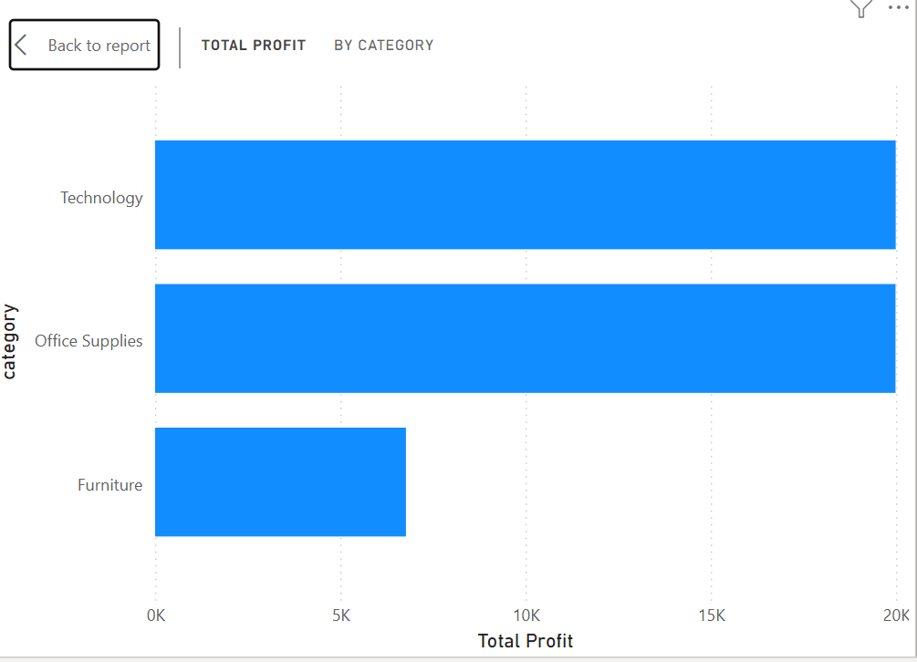
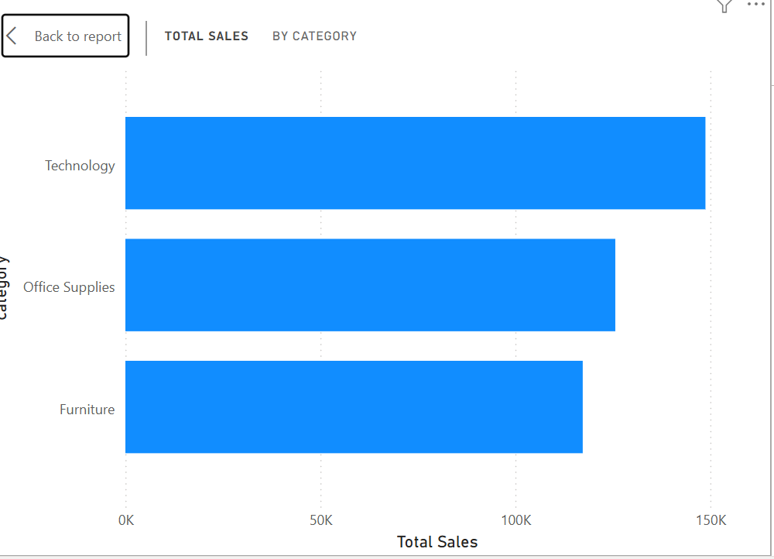
SALES & PROFIT ANALYSIS:
Key Observations:
Technology category generates highest total profit
Furniture shows reasonable sales but low profit contribution
Insight:
High sales volume does not always translate into high profitability.

Slide 8
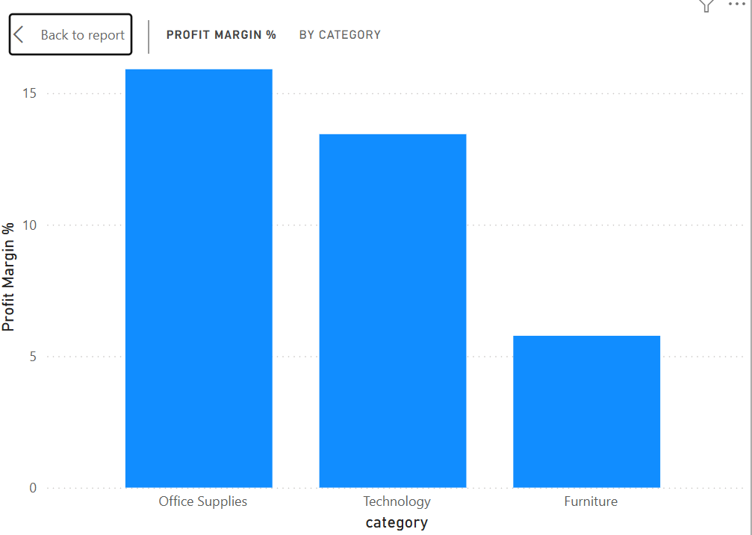
PROFIT MARGIN ANALYSIS:
Profit Margin Formula:
Profit Margin = (Total Profit / Total Sales) × 100
Findings:
Office Supplies has the highest profit margin
Furniture has the lowest profit margin
Insight:
Efficiency matters more than sales volume.

Slide 9
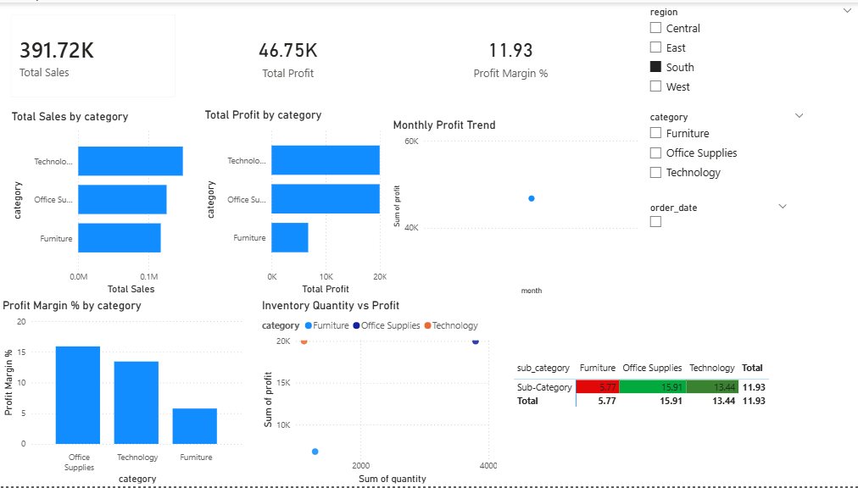
POWER BI DASHBOARD:

Slide 10
KEY INSIGHTS & RECOMMENDATIONS
Key Insights
Furniture is a profit-draining category
Office Supplies is the most efficient category
Inventory quantity alone does not drive profit
Seasonal trends strongly affect profitability
Recommendations
Optimize inventory for low-margin categories
Focus on high-margin products
Adopt seasonal stocking strategies
Track profit efficiency, not just sales

Slide 11
CONCLUSION:
This project demonstrates how combining SQL, Python, and Power BI enables:
Identification of hidden profit inefficiencies
Better inventory decision-making
Improved understanding of seasonal demand
Outcome:
Data-driven strategies can significantly improve retail profitability.

